Slide 1
Graph Optimization

Slide 2
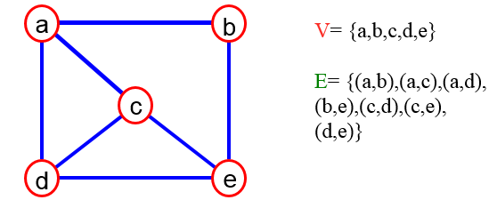
What is a Graph?
A graph G = (V,E) is composed of:
V: set of vertices
E: set of edges connecting the vertices in V
An edge e = (u,v) is a pair of vertices
Example:

Slide 3
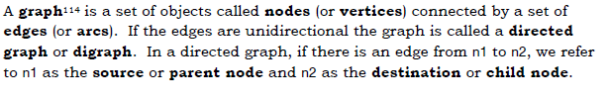
Graph, Directed Graph

Slide 4
Weighted Graph
If a weight is associated with each edge in a graph (or digraph) it is called a weighted graph.
Using weighted graphs, the highway system can be represented as a graph in which cities are represented by nodes and the highways connecting them as edges, where each edge is labeled with the distance between the two nodes.

Slide 5
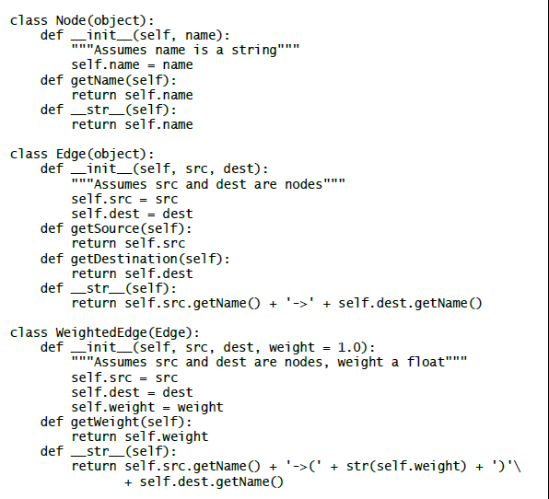
Program contains classes implementing abstract types corresponding to nodes, weighted edges, and edges.

Slide 6
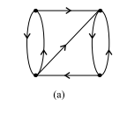
Diagraph
A digraph D is a pair (V, A), where V is a nonempty set whose elements are called the vertices and A is the subset of the set of ordered pairs of distinct elements of V. The elements of A are called the arcs of D.

Slide 7
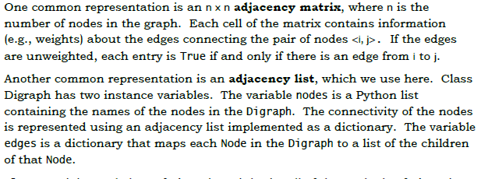
Diagraph Representation

Slide 8
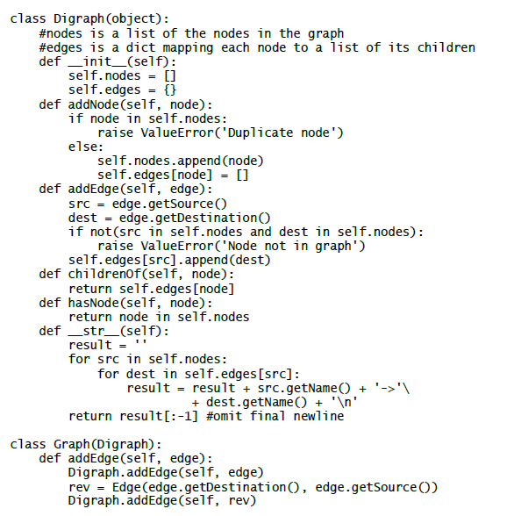

Slide 9
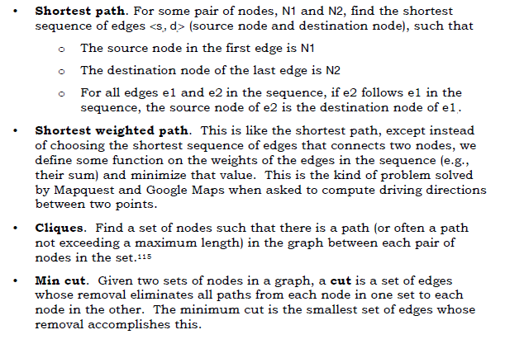
Some Classic Graph-Theoretic Problems

Slide 10
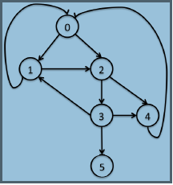
Shortest Path: Depth-First Search and Breadth-First Search

Slide 11
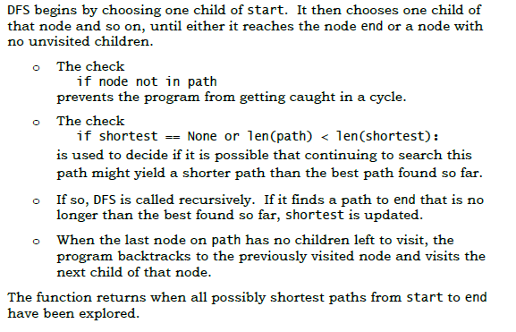
DFS Algorithm

Slide 12
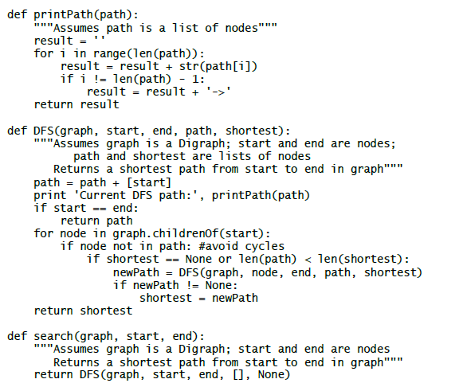
DFS Program

Slide 13
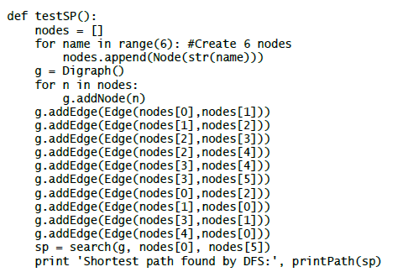
Test depth-first-search code

Slide 14
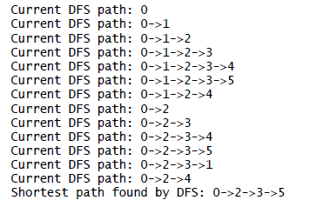
testSP produces the output

Slide 15
Conclusion of DFS
Notice that after exploring the path 0->1->2->3->4, it backs up to node 3 and explores the path 0->1->2->3->5.
After saving that as the shortest successful path so far, it backs up to node 2 and explores the path 0->1->2->4.
When it reaches the end of that path (node 4), it backs up all the way to node 0 and investigates the path starting with the edge from 0 to 2. And so on.

Slide 16
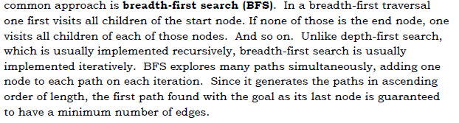
BFS

Slide 17
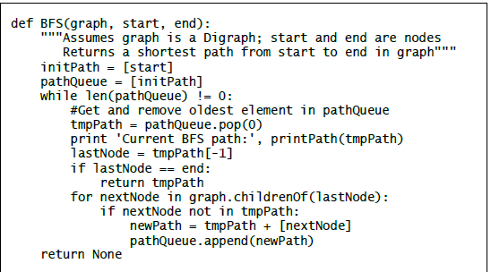
Function for DFS

Slide 18
Explanation
The variable pathQueue is used to store all of the paths currently being explored.
Each iteration starts by removing a path from pathQueue and assigning that path to tmpPath.
If the last node in tmpPath is end, tmpPath is returned. Otherwise, a set of new paths is created, each of which extends tmpPath by adding one of its children.
Each of these new paths is then added to pathQueue.

Slide 19
